Slide 1
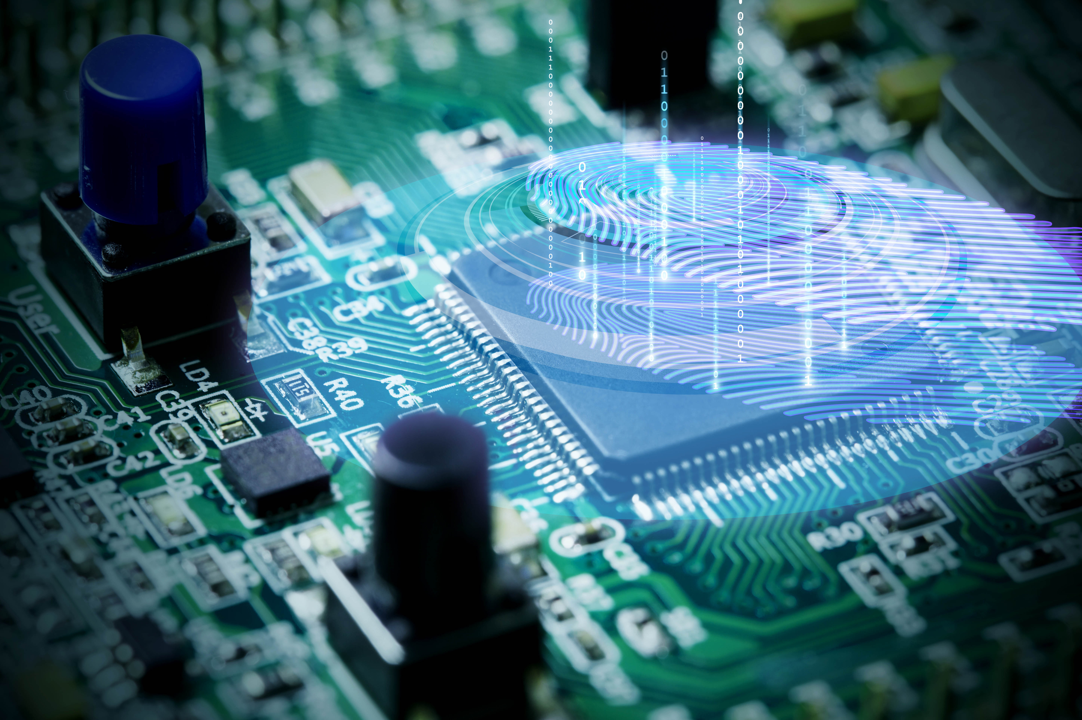

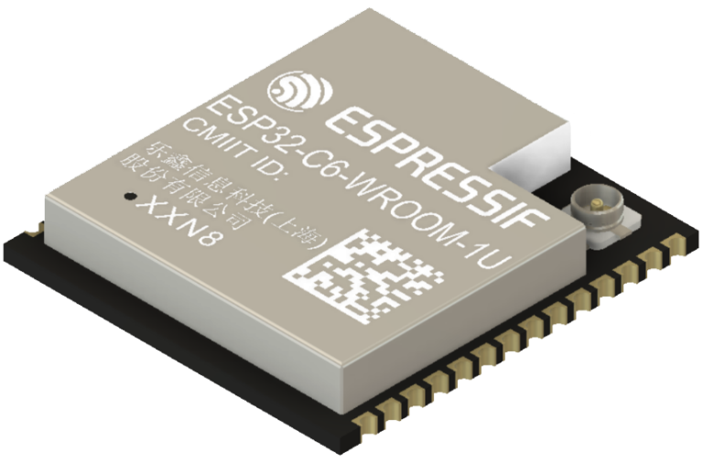

Table of Contents
30-Day FreeRTOS Course for ESP32 Using ESP-IDF
(Day 7)
“Hands-on Mini Project - Blinking Two LEDs with Two Tasks”

Slide 2
30-Day FreeRTOS Course for ESP32 Using ESP-IDF
Table of Contents
((Day 7)
“Hands-on Mini Project - Blinking Two LEDs with Two Tasks”

Slide 3
1. Overview
Table of Contents
Overview
Hardware Setup
Full Source Code (ESP-IDF + FreeRTOS)
What to Observe
Troubleshooting & Tips
Exercises (Optional Enhancements)
Summary

Slide 4
1. Overview

Slide 5
2. Hardware Setup
1. Overview
On Day 7, you’ll learn:
Wire two LEDs to your ESP32.
Create two FreeRTOS tasks:
Task A (uses vTaskDelay()) → LED1 @ 500 ms
Task B (uses vTaskDelayUntil()) → LED2 @ 1000 ms (fixed cadence)
Observe timing drift vs. steady period.
Measure drift using the tick counter.
Learn simple patterns for GPIO setup and periodic tasks.

Slide 6
2. Hardware Setup

Slide 7
3. Full Source Code (ESP-IDF + FreeRTOS)
2. Hardware Setup
LED1 anode → GPIO 2 (default; adjust for your board)
LED2 anode → GPIO 4
Each LED cathode → series resistor (220–330 Ω) → GND
Boards differ:
Many ESP32 DevKit boards expose GPIO2 with an onboard LED.
If your board routes these pins elsewhere, change the LED1_GPIO / LED2_GPIO defines accordingly.

Slide 8
3. Full Source Code (ESP-IDF + FreeRTOS)

Slide 9
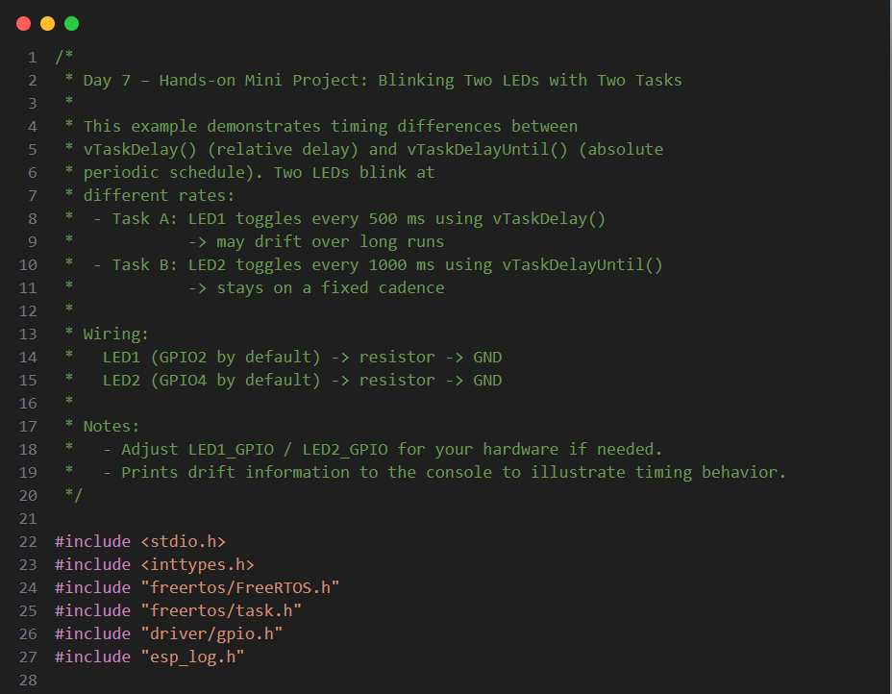
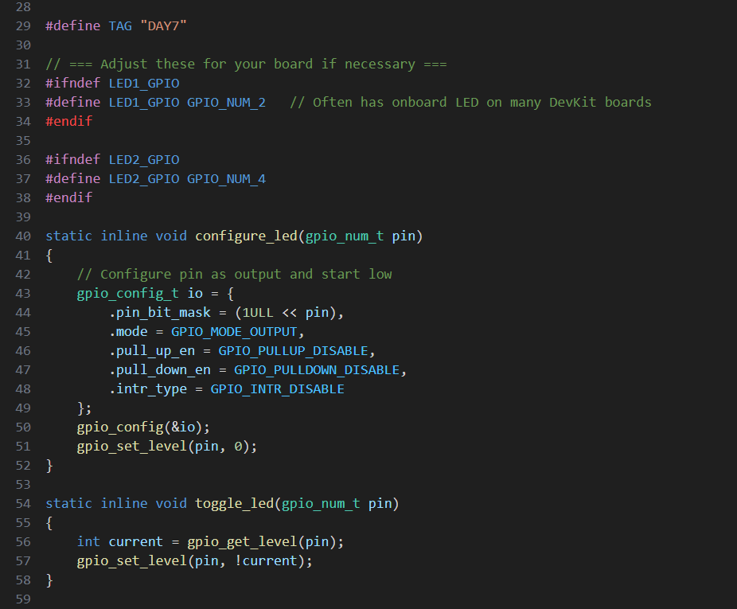
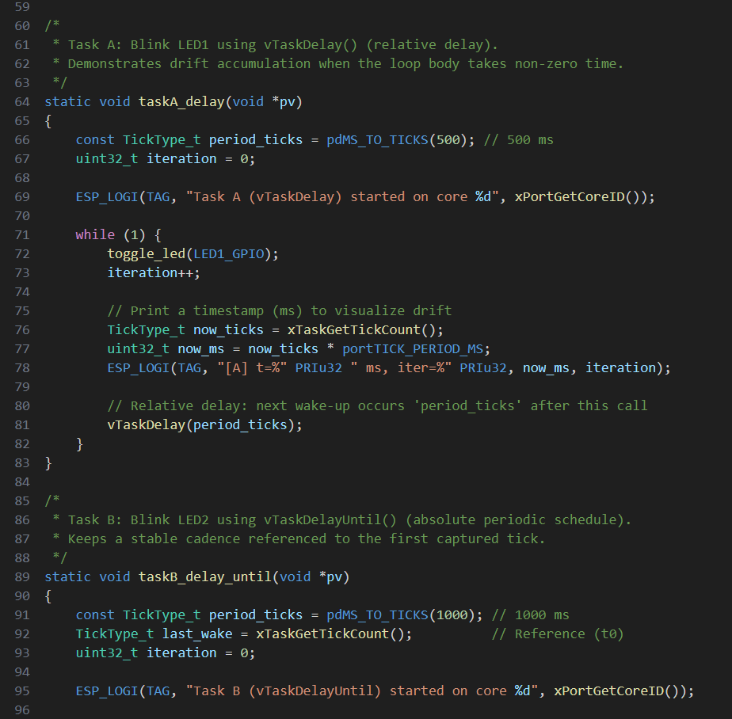
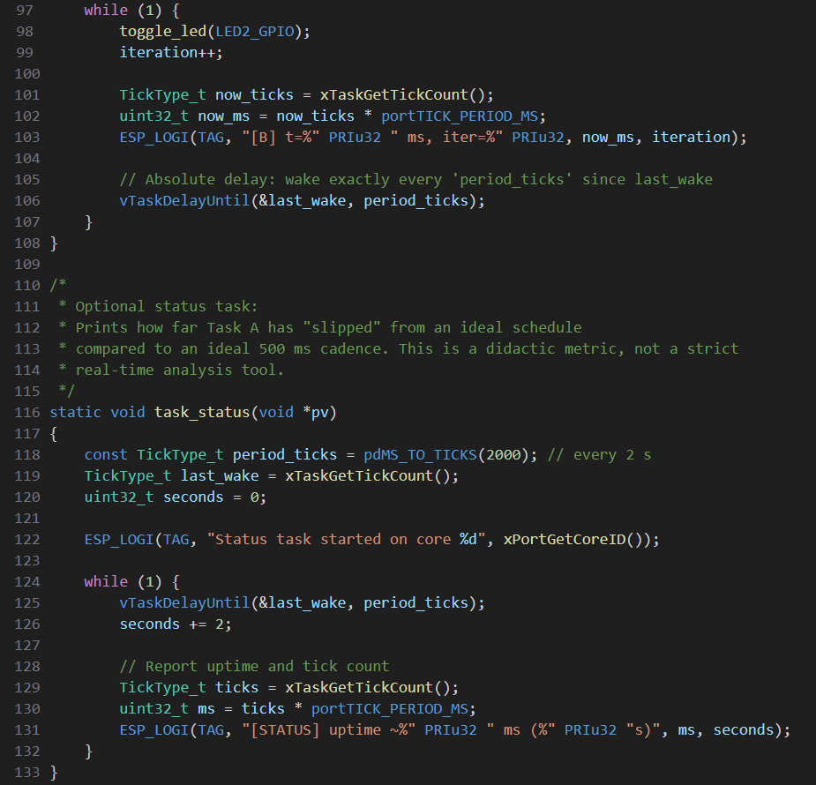
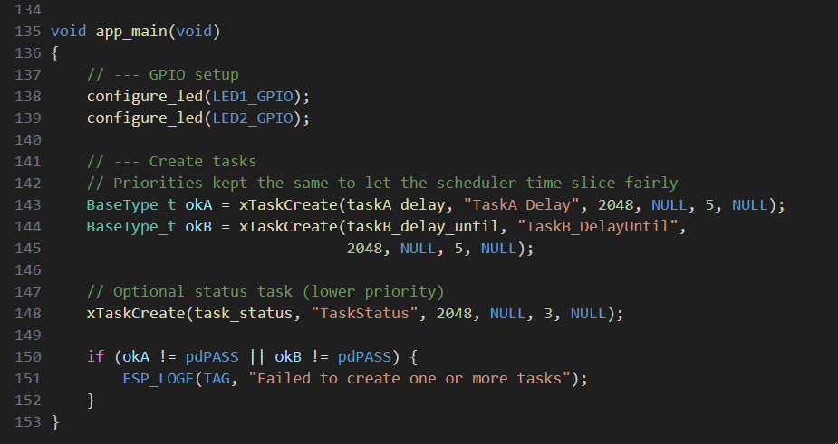
3. Full Source Code (ESP-IDF + FreeRTOS)

Slide 10
3. Full Source Code (ESP-IDF + FreeRTOS)

Slide 11
3. Full Source Code (ESP-IDF + FreeRTOS)

Slide 12
4. What to Observe
3. Full Source Code (ESP-IDF + FreeRTOS)

Slide 13
4. What to Observe

Slide 14
4. What to Observe
Open the serial monitor (idf.py monitor or the ESP-IDF Plugin Monitor Device option):
Lines prefixed [A]: timestamps for the vTaskDelay() task.
You’ll notice that execution time inside the loop adds on top of the delay, causing slight drift over time.
Lines prefixed [B]: timestamps for the vTaskDelayUntil() task.
Wake-ups occur at a fixed cadence (every 1000 ms), maintaining alignment with the initial reference tick (as long as the loop finishes before the next interval).
Why This Matters
vTaskDelay() is simple and fine for non-critical timing, but your period becomes “delay + work time”.
vTaskDelayUntil() creates true periodic tasks by scheduling the next wake-up at an absolute tick, greatly reducing cumulative drift.

Slide 15
Open the serial monitor (idf.py monitor or the ESP-IDF Plugin Monitor Device option):
Lines prefixed [A]: timestamps for the vTaskDelay() task.
You’ll notice that execution time inside the loop adds on top of the delay, causing slight drift over time.
Lines prefixed [B]: timestamps for the vTaskDelayUntil() task.
Wake-ups occur at a fixed cadence (every 1000 ms), maintaining alignment with the initial reference tick (as long as the loop finishes before the next interval).
5. Troubleshooting & Tips
4. What to Observe
Why This Matters
vTaskDelay() is simple and fine for non-critical timing, but your period becomes “delay + work time”.
vTaskDelayUntil() creates true periodic tasks by scheduling the next wake-up at an absolute tick, greatly reducing cumulative drift.

Slide 16
5. Troubleshooting & Tips

Slide 17
6. Exercises (Optional Enhancements)
5. Troubleshooting & Tips
If you don’t see LED activity, verify your GPIO numbers and wiring.
Some boards drive onboard LEDs active-low. If your LED seems inverted, swap the polarity or invert the logic.
If logs are too verbose, adjust the logging level in menuconfig → Component config → Log output or replace ESP_LOGI with printf.
Keep each task’s loop work shorter than its period. If a loop iteration exceeds the period, vTaskDelayUntil() will “catch up” (wake immediately), and you’ll see warning-level jitter.

Slide 18
6. Exercises (Optional Enhancements)

Slide 19
7. Summary
6. Exercises (Optional Enhancements)
Core Affinity: Pin Task A to Core 0 and Task B to Core 1 with xTaskCreatePinnedToCore(). Observe any differences.
Button Pause: Add a GPIO button that toggles pausing Task A using vTaskSuspend() / vTaskResume().
Timing Stress: Add a busy loop of 5–10 ms in Task A and watch drift increase vs. Task B’s stability.
Precision: Raise the tick rate to 1000 Hz in menuconfig (1 ms tick) and compare jitter.
Mutexed Logger: Wrap logging with a mutex so only one task prints at a time (teaser for Day 12).

Slide 20
7. Summary

Slide 21

6. Exercises (Optional Enhancements)
"Thanks for watching!
If you
enjoyed this video,
make sure to hit the like button and subscribe to stay updated with my latest content.
Don't forget to check out my other videos for more tips and tutorials on Embedded C, Python, hardware designs, etc. Keep exploring, keep learning, and I’ll see you in the next
video!"
7. Summary
Built two LED tasks to compare relative vs. absolute delays.
Observed drift with vTaskDelay() and steady cadence with vTaskDelayUntil().
Learned a clean pattern for GPIO setup and periodic task structure.
https://www.linkedin.com/in/yamil-garcia
https://www.youtube.com/@LearningByTutorials
https://github.com/god233012yamil

Slide 22
"Thanks for watching!
If you
enjoyed this video,
make sure to hit the like button and subscribe to stay updated with my latest content.
Don't forget to check out my other videos for more tips and tutorials on Embedded C, Python, hardware designs, etc. Keep exploring, keep learning, and I’ll see you in the next
video!"
https://www.linkedin.com/in/yamil-garcia
https://www.youtube.com/@LearningByTutorials
https://github.com/god233012yamil

